Slide 1


Measurement of differential production cross section for boosted top quarks in the all hadronic channel NTUA 23/9/2020
G. Bakas, K. Kousouris, I. Papakrivopoulos, G. Tsipolitis

Slide 2
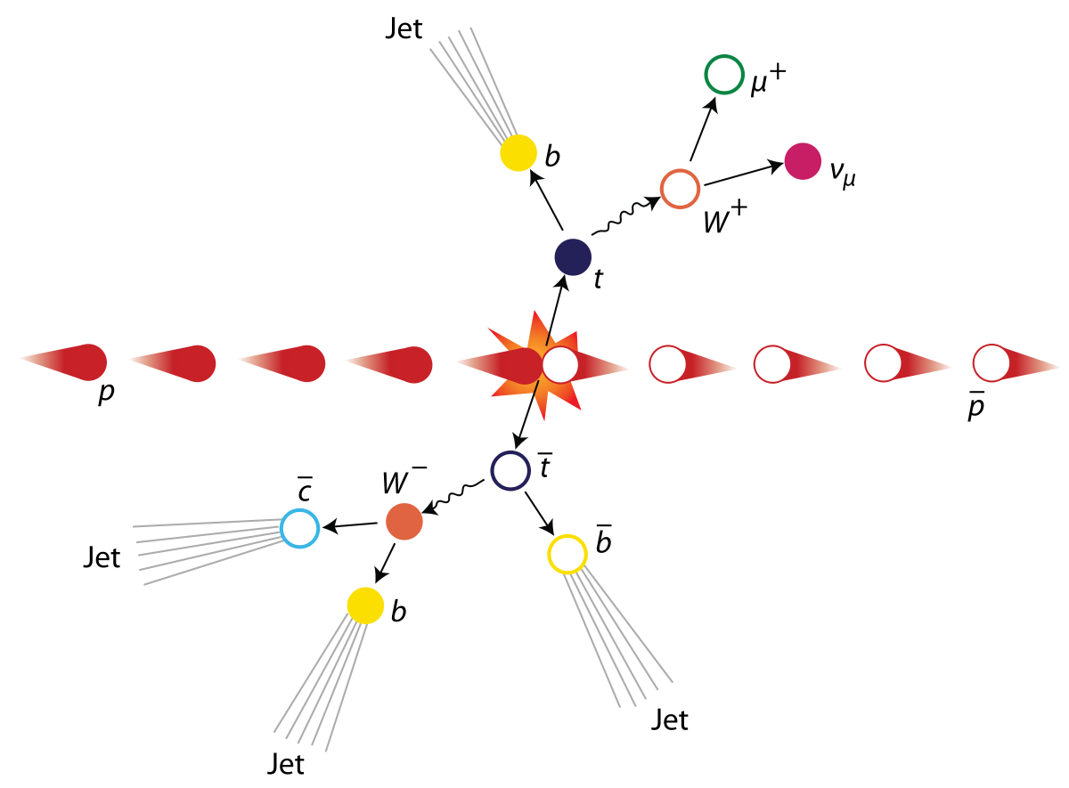
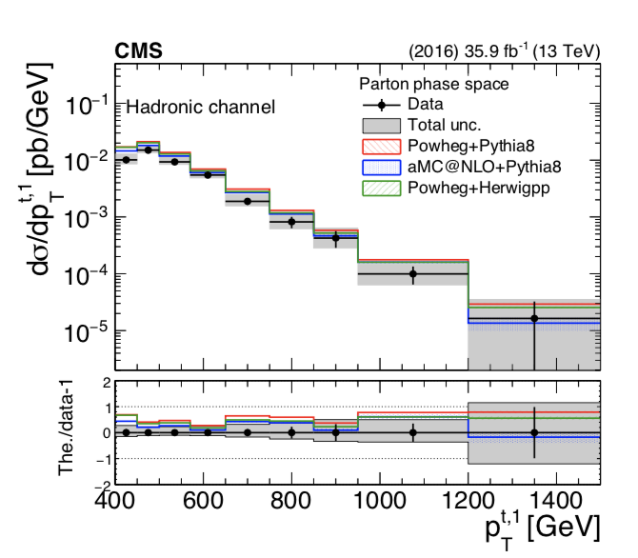
Motivation
Top, anti-top production in the fully hadronic
final state.
Trying to identify two big jets that contain the
products of the top/anti-top decay.

Slide 3

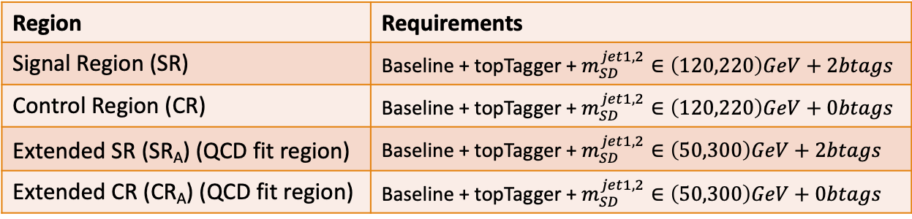
Overview
Region | Requirements
Signal Region (SR) | Baseline + topTagger + $m_{SD}^{jet1,2}∈\left(120,220\right)GeV+2btags$
Control Region (CR) | Baseline + topTagger + $m_{SD}^{jet1,2}∈\left(120,220\right)GeV+0btags$
Extended SR (SR_{A}) (QCD fit region) | Baseline + topTagger + $m_{SD}^{jet1,2}∈\left(50,300\right)GeV+2btags$
Extended CR (CR_{A}) (QCD fit region) | Baseline + topTagger + $m_{SD}^{jet1,2}∈\left(50,300\right)GeV+0btags$
Variables of interest:
ttbar mass, pt, rapidity
Leading and Subleading jetPt and |jetY|
Nominal ttbar MC samples
Mtt samples (700-1000, 1000-Inf) (only for 2016)
Goal is to Unfold to the Parton And Particle Levels
Closure Tests with Nominal MC’s
Unfolding and extrapolation with Data
Baseline Parton cuts:
Jet Matching
partonPt[0],[1] > 400
|partonEta[0],[1]| < 2.4
mTTbarParton > 1000 GeV
Discovered that our Control Region is contaminated from ttbar and Subdominant bkg:
Extract this contribution from the Data CR distribution → pure QCD
Baseline Reconstructed level cuts:
nJets > 1, nLeptons = 0, Dijet mass (mJJ) > 1000
Leading and Subleading jet p_{T} > 400
Leading and Subleading absolute jet eta |η|<2.4
Differences with TOP-18-013:
mJJ and mTTbarParton cut at 1000 GeV instead of 800 GeV
New top tagger, tagging jets and not events. The goal is to have higher efficiency in the far end of the spectrum
Btagging selection:
bTagging (medium WP deepCSV) (2016: 0.6321, 2017: 0.4941, 2018: 0.4184)
Top Tagger WP:
New top Tagger: (2016: 0.2, 2017:0.0, 2018: 0.1)
B tagging SF’s are applied

Slide 4
Efficiency and Acceptance Plots
2017 and 2018 Efficiency drops ↓

Slide 5
Efficiency and Acceptance Plots
2017 and 2018 Efficiency drops ↓

Slide 6
Response Matrices 2016
(2016)
(2017)
(2018)
Assuming that response matrices are compatible to each other
Unfold each year and combine results?
Combine Fiducial Measurements and then unfold

Slide 7
Contamination Plots Medium WP (CR) 2016, 2017, 2018
(2016)
(2017)
(2018)

Slide 8
Contamination Plots Medium WP (CR) 2016, 2017, 2018
Comment
Shapes and in general contamination is NOT affected by btagging by Scale factors

Slide 9
Mass Fit in Extended SR (SR_{A})
Both SR and Control Region use the Medium btag WP.
Intuition is to remove the ttbar and subdominant bkg contribution from the data Control Region
$$QCD_{0}\left(m^{t}\right)=D_{0}\left(m^{t}\right)−T_{0}\left(m^{t}\right)−Sub_{0}\left(m^{t}\right)$$
(2016)
(2017)
(2018)
Floating Parameter FinalValue +/- Error
-------------------- --------------------------
kMassResol 9.2251e-01 +/- 2.73e-02
kMassScale 9.9891e-01 +/- 2.01e-03
kQCD_2b 6.9753e-02 +/- 5.26e-02
nFitBkg_2b 2.4472e+02 +/- 1.47e+02
nFitQCD_2b 2.9890e+03 +/- 1.74e+02
nFitSig2b 5.2763e+03 +/- 1.67e+02
Signal strength: r = 0.686668 ± 0.0263103 (new)
Floating Parameter FinalValue +/- Error
-------------------- --------------------------
kMassResol 1.0071e+00 +/- 2.84e-02
kMassScale 9.9006e-01 +/- 1.92e-03
kQCD_2b 1.2862e-02 +/- 2.71e-03
nFitBkg_2b 1.0737e+02 +/- 2.97e+02
nFitQCD_2b 5.0444e+03 +/- 2.83e+02
nFitSig2b 7.6593e+03 +/- 1.86e+02
Signal strength: r = 0.683382 ± 0.0200866
Floating Parameter FinalValue +/- Error
-------------------- --------------------------
kMassResol 1.0998e+00 +/- 4.02e-02
kMassScale 9.8340e-01 +/- 2.66e-03
kQCD_2b 1.6593e-02 +/- 7.44e-03
nFitBkg_2b 4.9791e+02 +/- 2.68e+02
nFitQCD_2b 2.1662e+03 +/- 3.11e+02
nFitSig2b 4.8059e+03 +/- 1.50e+02
Signal strength: r = 0.644361 ± 0.023851 (new)

Slide 10
Signal Strength Results

Slide 11
Signal Extraction
Fitted number of QCD events in SR_{A}
Measured dist from data
QCD shape taken from Data (CR)
$$S\left(x_{reco}\right)=D\left(x_{reco}\right)−C_{bkg}^{yield}N_{QCD}^{fit}C_{QCD}^{shape}\left(x_{reco}\right)Q\left(x_{reco}\right)−B(x_{reco})$$
Fiducial Yield
Transfer factor from SR_{A} to SR
QCD shape correction factor
Subdominant bkg shape and contribution (MC)
Where x_{reco} is the respected variable of interest (ttbar mass, pt, rapidity, leading and subleading jetPt and |jetY|)
We deploy a fit in the Signal Region (2btag) to extract the $N_{QCD}^{fit}$
$$D{\left(m^{t}\right)}^{(i)}=N_{tt}^{(i)}T^{(i)}\left(m^{t},k_{MassScale}, k_{MassResolution}\right)+N_{bkg}^{(i)}B\left(m^{t} \right)\left(1+k_{1}x\right)+N_{sub}^{(i)}O^{(i)}\left(m^{t}\right)$$
Our data CR is contaminated from ttbar and subdominant bkgs which has to be dealt with.

Slide 12
Fiducial Differential Cross Section
(2016)
(2017)
(2018)

Slide 13
Fiducial Differential Cross Section
(2016)
(2017)
(2018)

Slide 14
Fiducial Differential Cross Section (Normalized)
(2016)
(2017)
(2018)

Slide 15
Fiducial Differential Cross Section (Normalized)
(2016)
(2017)
(2018)

Slide 16
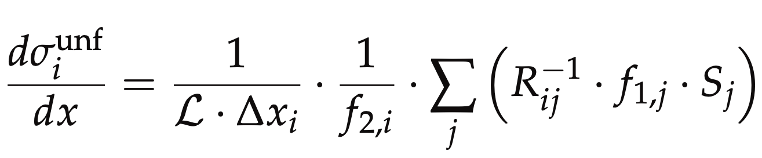

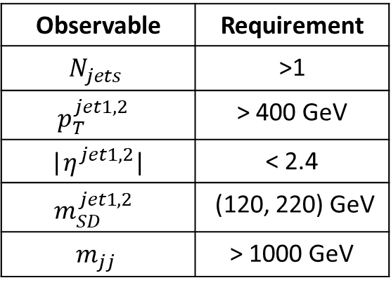
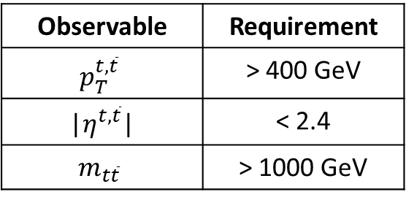
Parton & Particle levels
Particle level Top Candidates
Parton
Observable | Requirement
$$N_{jets}$$ | >1
$$p_{T}^{jet1, 2 }$$ | > 400 GeV
|$η^{jet1, 2}$| | < 2.4
$$m_{SD}^{jet1, 2 }$$ | (120, 220) GeV
$$m_{jj}$$ | > 1000 GeV
Observable | Requirement
$$p_{T}^{t,\overline{t}}$$ | > 400 GeV
|$η^{t,\overline{t}}$| | < 2.4
$$m_{t\overline{t}}$$ | > 1000 GeV
Parton Phase space
Reco/Fiducial Phase space
efficiency of the reco+true selection
reco efficiency of the reco+true selection
migration matrix
Unfolding: simple response matrix inversion w/o regularisation

Slide 17
Parton Differential Cross Section
(2016)
(2017)
(2018)
(2016)
(2017)
(2018)

Slide 18
Parton Differential Cross Section Comparison

Slide 19
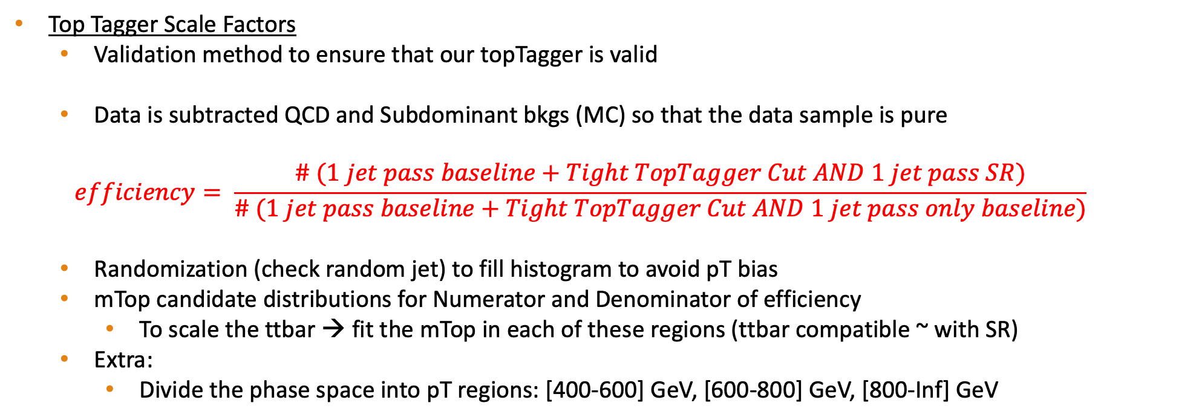
Tag And Probe
Top Tagger Scale Factors
Validation method to ensure that our topTagger is valid
Data is subtracted QCD and Subdominant bkgs (MC) so that the data sample is pure
$$efficiency= \frac{\# (1 jet pass baseline+Tight TopTagger Cut AND 1 jet pass SR)}{\# (1 jet pass baseline+Tight TopTagger Cut AND 1 jet pass only baseline)}$$
Randomization (check random jet) to fill histogram to avoid pT bias
mTop candidate distributions for Numerator and Denominator of efficiency
To scale the ttbar → fit the mTop in each of these regions (ttbar compatible ~ with SR)
Extra:
Divide the phase space into pT regions: [400-600] GeV, [600-800] GeV, [800-Inf] GeV

Slide 20
Tag And Probe Calculations 2016
(2016)
(2017)
(2018)
eff data: 0.781 ± 0.038
eff ttbar: 0.772 ± 0.014
-----------
Efficiency per Pt region
eff data pT[400-600]: 0.761 ± 0.042
eff ttbar pT[400-600]: 0.778 ± 0.016
-----------
eff data pT[600-800]: 0.851 ± 0.100
eff ttbar pT[600-800]: 0.748 ± 0.031
-----------
eff data pT[800-Inf]: 0.886 ± 0.160
eff ttbar pT[800-Inf]: 0.775 ± 0.063
eff data: 0.857 ± 0.040
eff ttbar: 0.875 ± 0.0072
-----------
Efficiency per Pt region
eff data pT[400-600]: 0.872 ± 0.047
eff ttbar pT[400-600]: 0.874 ± 0.008
-----------
eff data pT[600-800]: 0.795 ± 0.088
eff ttbar pT[600-800]: 0.876 ± 0.018
-----------
eff data pT[800-Inf]: 0.797 ± 0.186
eff ttbar pT[800-Inf]: 0.899 ± 0.045
eff data: 0.798 ± 0.034
eff ttbar: 0.839 ± 0.005
-----------
Efficiency per Pt region
eff data pT[400-600]: 0.793 ± 0.04
eff ttbar pT[400-600]: 0.836 ± 0.006
-----------
eff data pT[600-800]: 0.829 ± 0.066
eff ttbar pT[600-800]: 0.851 ± 0.013
-----------
eff data pT[800-Inf]: 0.752 ± 0.13
eff ttbar pT[800-Inf]: 0.865 ± 0.032

Slide 21
Tight TopTagger + SR TopTagger
TagAndProbe Efficiency Plots
Tight TopTagger + Probe

Slide 22
Summary
We have identified the source of contamination in the control region which allowed us to have a better fit result.
We have extracted the first results of the cross section in the Fiducial and the unfolded level.
We continue to optimize the binning in order to get better results.
Investigate on how to apply the b-tagging scaling factors.
Investigate on how to combine the measurements between the three years
Combine them in the fiducial level and extract the cross section?
Extract the cross sections individually and combine the measurements in the unfolded level?
Wait for ultra legacy files?

Slide 23
BACKUP

Slide 24
Signal Selection
Control Region Selection
Variables | Selected Cut
pT (both leading jets) | > 400 GeV
Njets | > 1
N leptons | = 0
|eta| (both leading jets) | < 2.4
mJJ | > 1000 GeV
jetMassSoftDrop (only for fit) | (50,300) GeV
Top Tagger | > 0.2, 0, 0.1
B tagging (2 btagged jets) | > Medium WP
Signal Trigger
Variables | Selected Cut
pT (both leading jets) | > 400 GeV
Njets | > 1
N leptons | = 0
|eta| (both leading jets) | < 2.4
mJJ | > 1000 GeV
jetMassSoftDrop (only for fit) | (50,300) GeV
Top Tagger | > 0.2, 0, 0.1
B tagging (0 btagged jets) | < Medium WP
Control Trigger

Slide 25
Year | Type of File | DAS
2016 | TT Mtt 700-1000 | /TT_Mtt-700to1000_TuneCUETP8M2T4_13TeV-powheg-pythia8/RunIISummer16MiniAODv3-PUMoriond17_94X_mcRun2_asymptotic_v3-v2/MINIAODSIM
 | TT Mtt 1000-Inf | /TT_Mtt-1000toInf_TuneCUETP8M2T4_13TeV-powheg-pythia8/RunIISummer16MiniAODv3-PUMoriond17_94X_mcRun2_asymptotic_v3-v2/MINIAODSIM
 | TT Nominal | /TT_TuneCUETP8M2T4_13TeV-powheg-pythia8/RunIISummer16MiniAODv3-PUMoriond17_94X_mcRun2_asymptotic_v3-v1/MINIAODSIM
2017 | TT Mtt 700-1000 | sdasdasd
 | TT Mtt 1000-Inf | --
 | TT Nominal Hadronic | /TTToHadronic_TuneCP5_13TeV-powheg-pythia8/RunIIFall17MiniAODv2-PU2017_12Apr2018_94X_mc2017_realistic_v14-v1/MINIAODSIM
 | TT Nominal Semilepton | /TTToSemiLeptonic_TuneCP5_13TeV-powheg-pythia8/RunIIFall17MiniAODv2-PU2017_12Apr2018_94X_mc2017_realistic_v14-v2/MINIAODSIM
 | TT Nominal Dilepton | TTTo2L2Nu_TuneCP5_13TeV-powheg-pythia8/RunIIFall17MiniAODv2-PU2017_12Apr2018_94X_mc2017_realistic_v14-v2/MINIAODSIM
2018 | TT Mtt 700-1000 | --
 | TT Mtt 1000-Inf | asdasdasda
 | TT Nominal Hadronic | /TTToHadronic_TuneCP5_13TeV-powheg-pythia8/RunIIAutumn18MiniAOD-102X_upgrade2018_realistic_v15-v1/MINIAODSIM
 | TT Nominal Semilepton | /TTToSemiLeptonic_TuneCP5_13TeV-powheg-pythia8/RunIIAutumn18MiniAOD-102X_upgrade2018_realistic_v15-v1/MINIAODSIM
 | TT Nominal Dilepton | /TTTo2L2Nu_TuneCP5_13TeV-powheg-pythia8/RunIIAutumn18MiniAOD-102X_upgrade2018_realistic_v15-v1/MINIAODSIM
BACKUP SLIDES

Slide 26
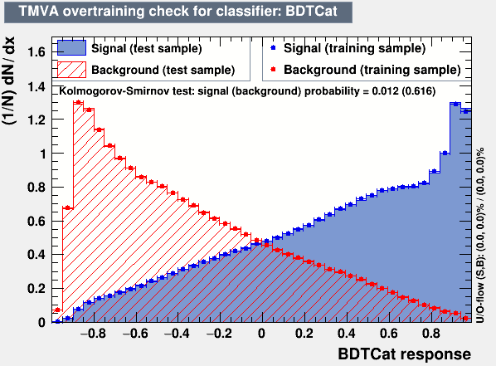
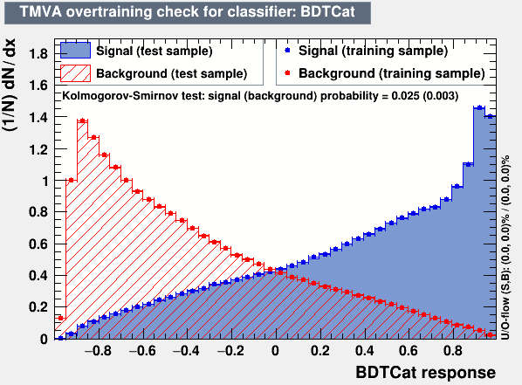
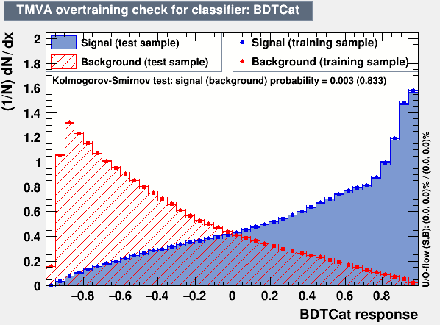
Overview: Discriminator, Efficiency and Acceptance
2016
The discriminator is a BDT trained individually for 2016, 2017 and 2018
Category training: split the sample in categories based on Pt
Bins:
[400, 600] GeV
[600, 800] GeV
[800, 1200] GeV
[1200, inf) GeV
BDT, used variables:
Leading and Sub-leading subjet mass
N-Subjetiness variables (tau1, tau2, tau3)
fraction of the jetPt over the total pt sum of the event.
Energy correlation functions (ecfB1N2,ecfB1N3, ecfB2N2, ecfB2N3)
BDT Output consistency for the 3 years
Calculation of Efficiency and acceptance for each year
We choose the WP’s for each year so that the leading jet p_{T} efficiency is similar for all years
2017
2018

Slide 27
Fit Params Results Comparison

Slide 28
Response Matrices 2016
b tagging SF’s
without b tagging SF’s

Slide 29
Response Matrices 2017
b tagging SF’s
without b tagging SF’s

Slide 30
Response Matrices 2018
b tagging SF’s
without b tagging SF’s

Slide 31
Tag And Probe Calculations 2016
b tagging SF’s
without b tagging SF’s
Efficiency--with btagging SF's
eff data: 0.781 ± 0.038
eff ttbar: 0.772 ± 0.014
-----------
Efficiency per Pt region
eff data pT[400-600]: 0.761 ± 0.042
eff ttbar pT[400-600]: 0.778 ± 0.016
-----------
eff data pT[600-800]: 0.851 ± 0.100
eff ttbar pT[600-800]: 0.748 ± 0.031
-----------
eff data pT[800-Inf]: 0.886 ± 0.160
eff ttbar pT[800-Inf]: 0.775 ± 0.063
Efficiency--without btagging SF's
eff data: 0.782 ± 0.039
eff ttbar: 0.772 ± 0.014
-----------
Efficiency per Pt region
eff data pT[400-600]: 0.762 ± 0.043
eff ttbar pT[400-600]: 0.778 ± 0.016
-----------
eff data pT[600-800]: 0.854 ± 0.103
eff ttbar pT[600-800]: 0.748 ± 0.031
-----------
eff data pT[800-Inf]: 0.888 ± 0.161
eff ttbar pT[800-Inf]: 0.775 ± 0.064

Slide 32
Tag And Probe Calculations 2017
b tagging SF’s
without b tagging SF’s
Efficiency-- with btagging SF's
eff data: 0.857 ± 0.040
eff ttbar: 0.875 ± 0.0072
-----------
Efficiency per Pt region
eff data pT[400-600]: 0.872 ± 0.047
eff ttbar pT[400-600]: 0.874 ± 0.008
-----------
eff data pT[600-800]: 0.795 ± 0.088
eff ttbar pT[600-800]: 0.876 ± 0.018
-----------
eff data pT[800-Inf]: 0.797 ± 0.186
eff ttbar pT[800-Inf]: 0.899 ± 0.045
Efficiency-- without btagging SF's
eff data: 0.864 ± 0.043
eff ttbar: 0.875 ± 0.007
-----------
Efficiency per Pt region
eff data pT[400-600]: 0.880 ± 0.049
eff ttbar pT[400-600]: 0.874 ± 0.008
-----------
eff data pT[600-800]: 0.8 ± 0.091
eff ttbar pT[600-800]: 0.876 ± 0.018
-----------
eff data pT[800-Inf]: 0.796 ± 0.2
eff ttbar pT[800-Inf]: 0.898 ± 0.045

Slide 33
Tag And Probe Calculations 2018
b tagging SF’s
without b tagging SF’s
Efficiency-- with tag SF's
eff data: 0.816 ± 0.032
eff ttbar: 0.839 ± 0.005
-----------
Efficiency per Pt region
eff data pT[400-600]: 0.8176 ± 0.038
eff ttbar pT[400-600]: 0.837 ± 0.006
-----------
eff data pT[600-800]: 0.809 ± 0.063
eff ttbar pT[600-800]: 0.847 ± 0.013
-----------
eff data pT[800-Inf]: 0.772 ± 0.132
eff ttbar pT[800-Inf]: 0.868 ± 0.032
Efficiency-- without tag sf's
eff data: 0.822 ± 0.034
eff ttbar: 0.839 ± 0.005
-----------
Efficiency per Pt region
eff data pT[400-600]: 0.824 ± 0.039
eff ttbar pT[400-600]: 0.837 ± 0.006
-----------
eff data pT[600-800]: 0.819 ± 0.066
eff ttbar pT[600-800]: 0.847 ± 0.013
-----------
eff data pT[800-Inf]: 0.789 ± 0.141
eff ttbar pT[800-Inf]: 0.868 ± 0.032

